Slide 1
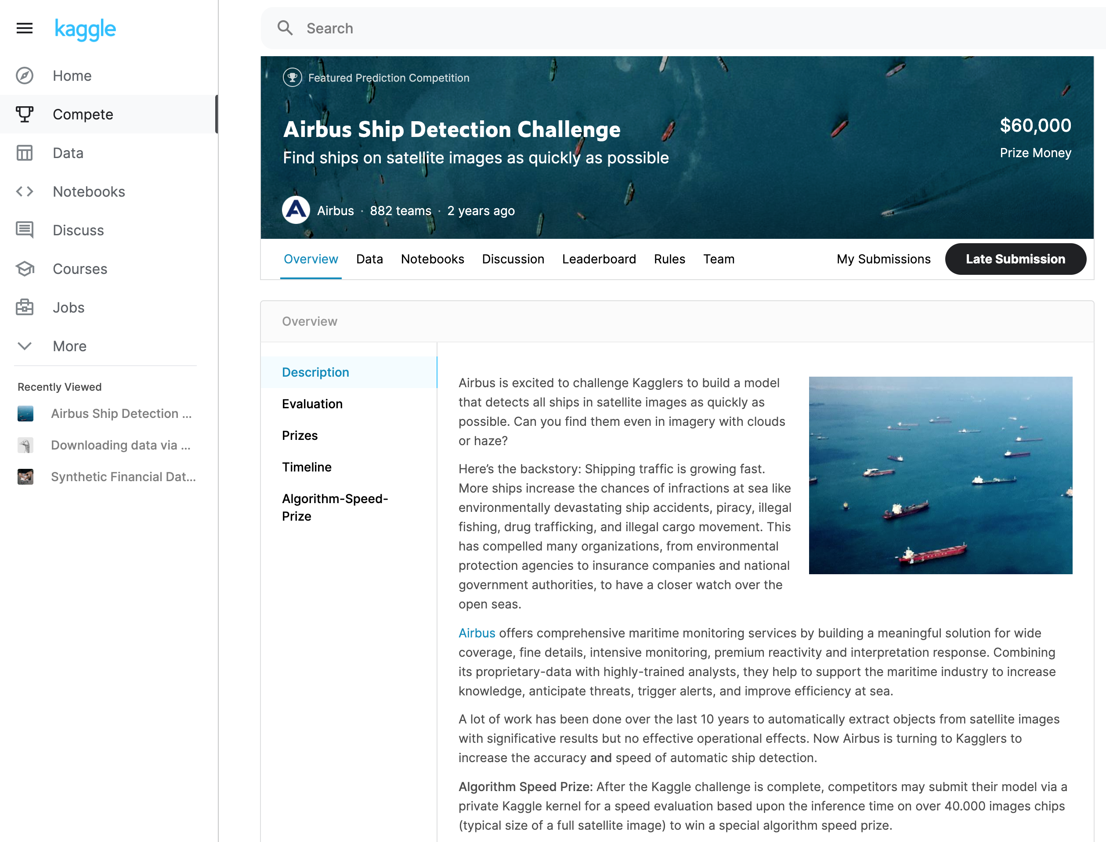
References
Airbus Ship-Data
Source: Architecting ML on AWS github & Kaggle
Write-Up:https://github.com/aws-samples/amazon-sagemaker-architecting-for-ml/blob/master/Writeups/Object%20Detection.md
Starter Code: https://github.com/aws-samples/amazon-sagemaker-architecting-for-ml/blob/master/Starter-Code/ship-data-transformation.ipynb

Slide 2
Debugging Tools

Slide 3
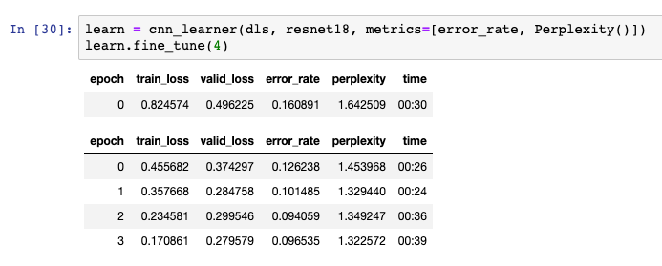
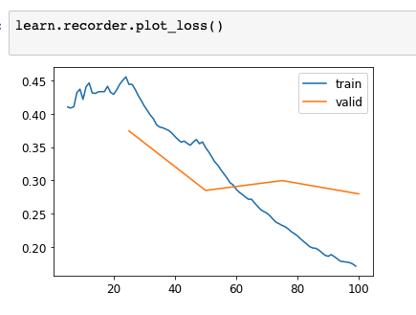
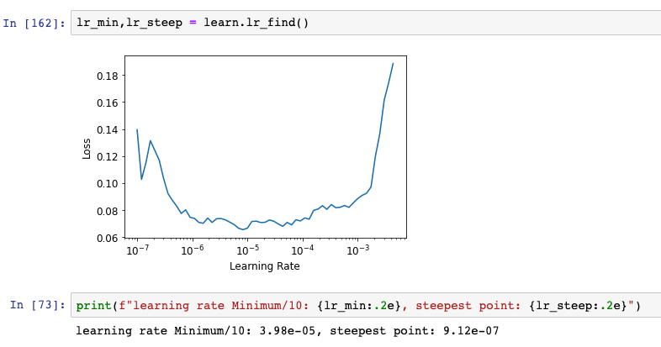
Verbose code for Debugging/Analyzing
Metrics=[….]
LR find()
Plot_loss()

Slide 4
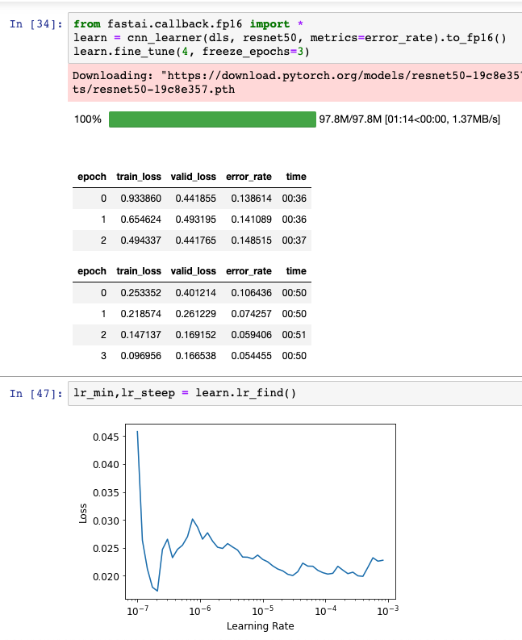
Let’s Try ResNet50 (instead of ResNet18)

Slide 5
Regression
Previously, we did binary classification (using fastai Notebook 02) for ship data.
ShipYes = ship exists in photo
ShipNo = No ship exists in photo
This time, we do regression (using fastai Notebook 05)
The Kaggle dataset has bounding boxes for each ship. If we convert them to points (centroids of boxes), we could use to point WHERE the ship is in the picture
Point(X,Y) <- Location of the ship in the photo

Slide 6
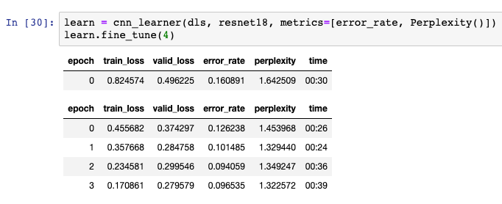
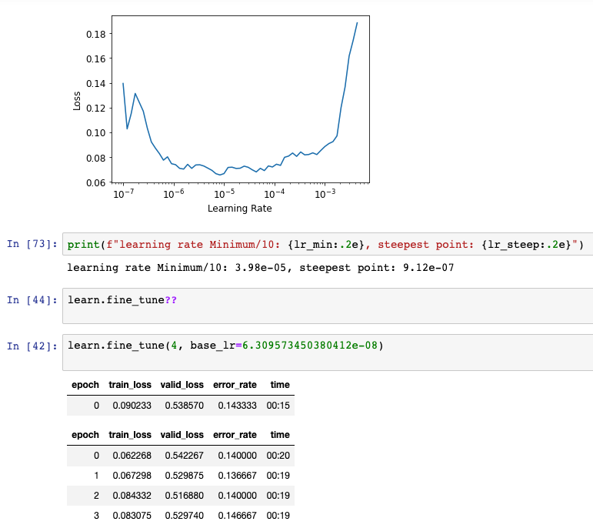
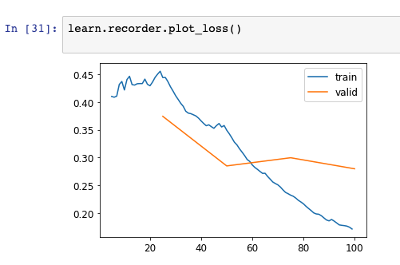
LR_Finder
no LR_find()
LR_find()

Slide 7
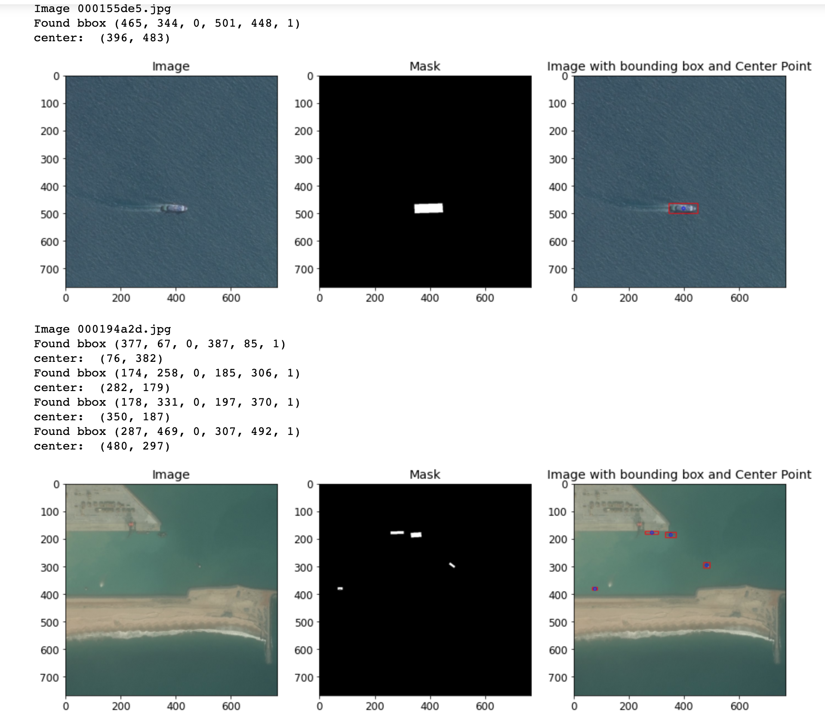
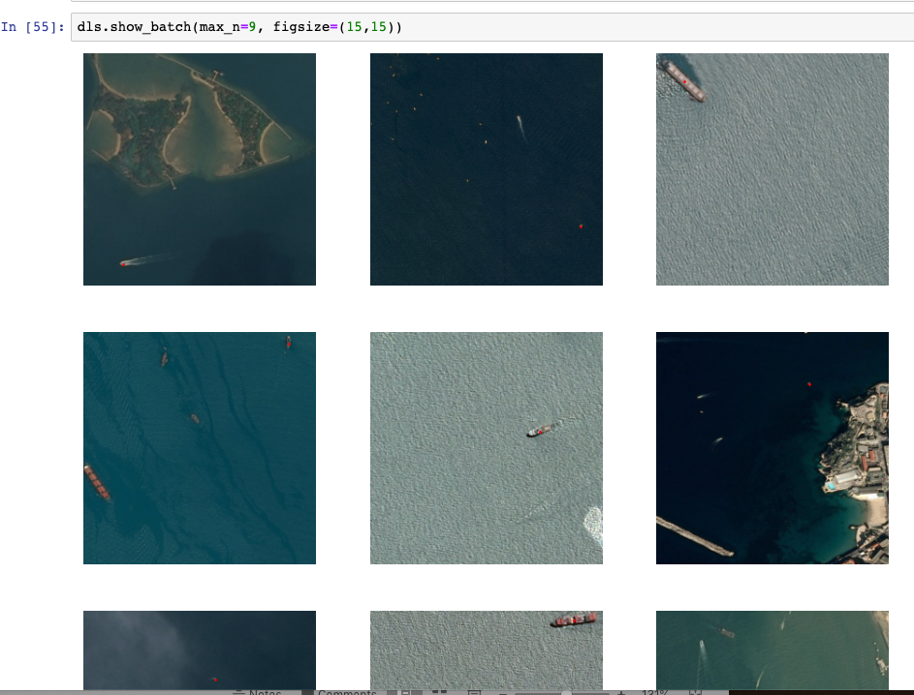
CNN Regression
Simplified: Convert to centroid Point for each ship.
Use it for regression
Labeled Data has bounding boxes for all ships

Slide 8
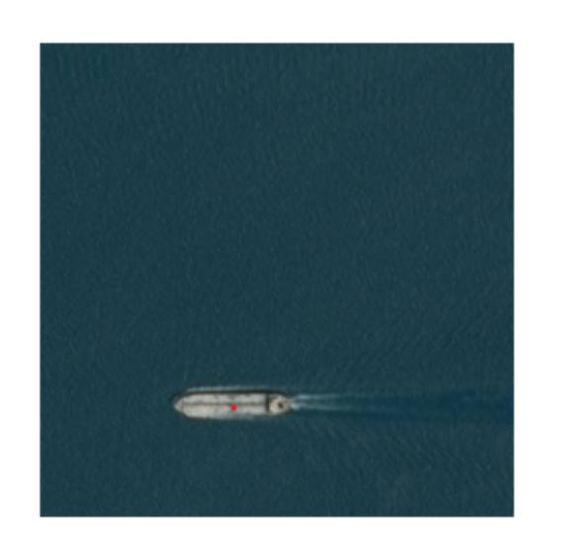
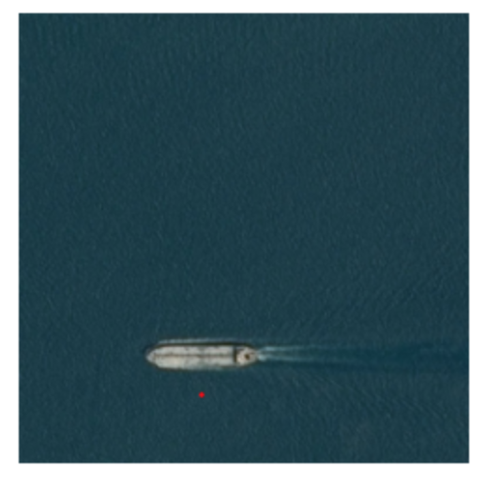
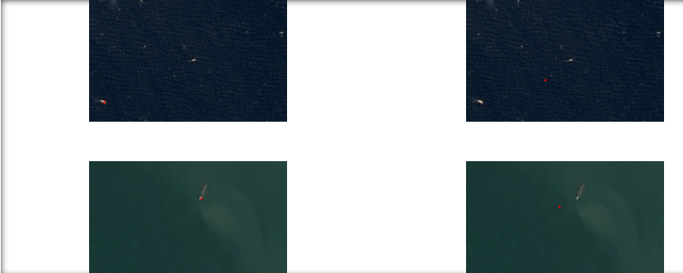
Regression Outcome
Results (PointBlock)
Red Point: Groundtruth point
Red Point: Predicted point
(Distance to actual ship location is the Error)

Slide 9
More Debugging Tools (Activation Maps)

Slide 10
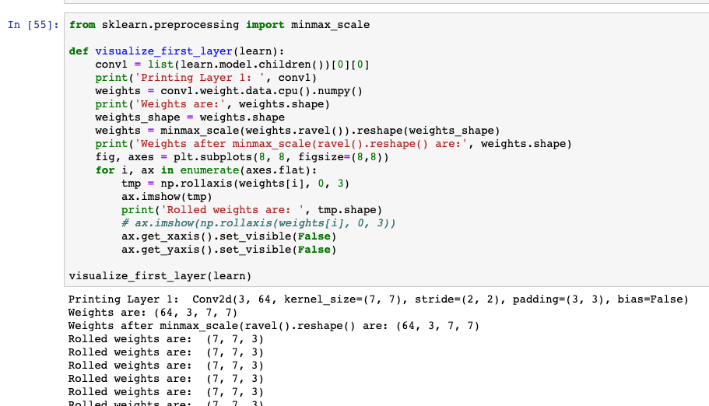
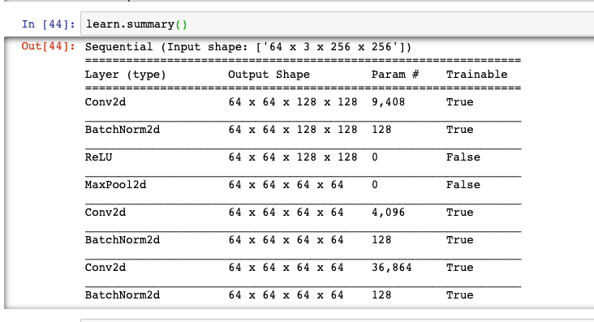
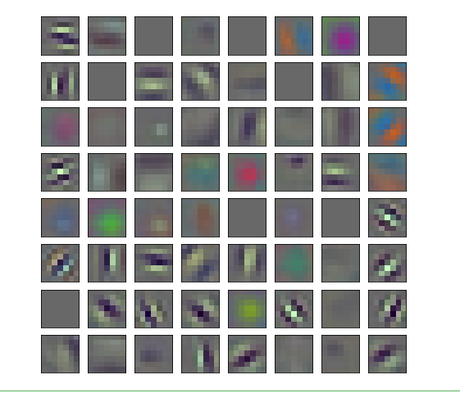
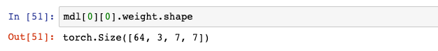
Activation Maps
mdl[1]
mdl[0][4]
mdl[0][1]
02_production-airbus-ship-data-pa4-verbose

Slide 11
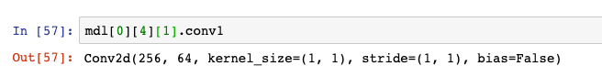
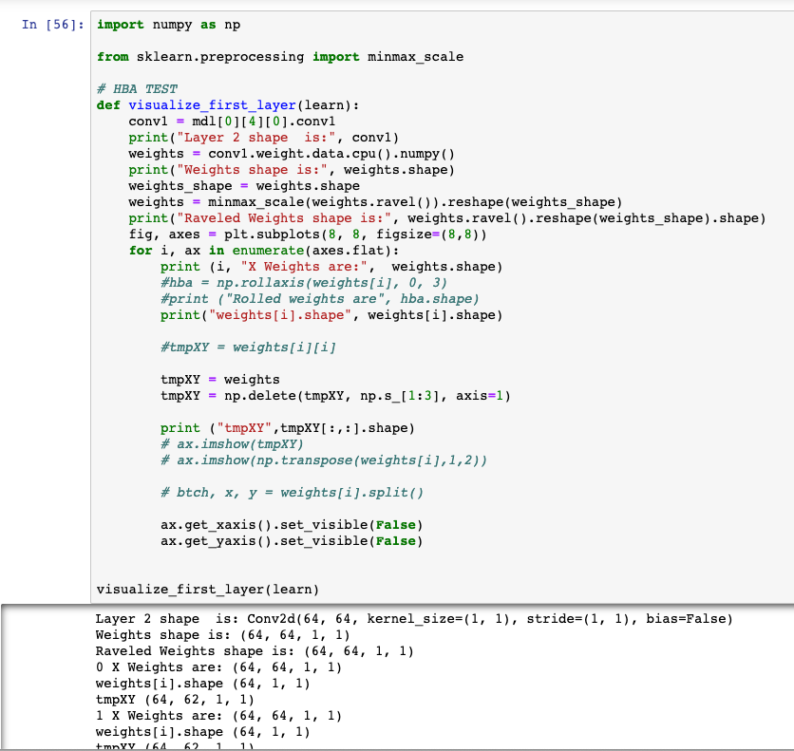
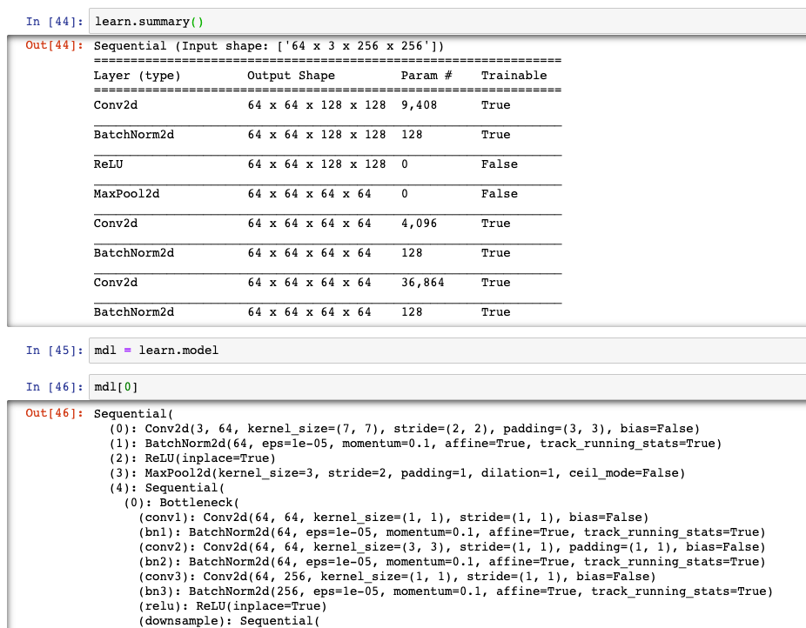
Stuck Here

